Slide 1

18ECC205J - Analog and Digital Communication UNIT 2
Contents of Week 3 Lecture
Noise in FM System
Problems in Unit 2
Source: Singh. R. P & Sapre. S. D, “Communication Systems: Analog & Digital,” 3rd edition, McGrawHill Education, Seventh Reprint, 2016.

Slide 2
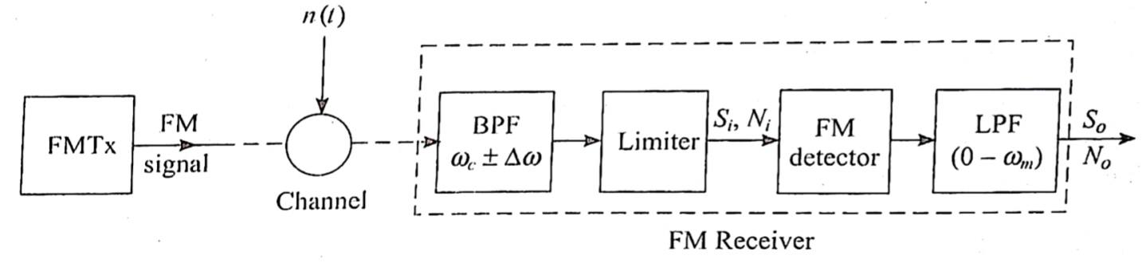
Noise in FM
The bandpass filter selects the desired carrier along with sidebands.
FM detector comprises a frequency discriminator followed by envelope detector.
The input to FM detector is maintained constant by a limiter. The output of receiver is the baseband signal f(t).
Let input and output signal powers be (Si, So) and noise powers be (Ni, No).

Slide 3
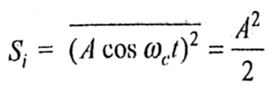
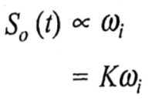




Signal Power
The power of FM signal will be same as that of an unmodulated carrier as the amplitude remains unchanged after modulation.
For computing the output signal power, the noise is assumed to be absent. The output of detector So(t) is proportional to instantaneous frequency of FM.
Where K is proportionality constant.
The angular frequency depends on modulating signal and is given by
Hence So(t) = in which the useful message is
The signal power due to this message term is

Slide 4




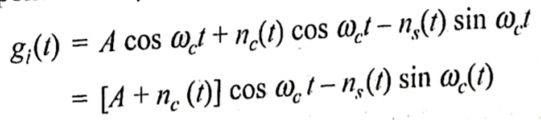
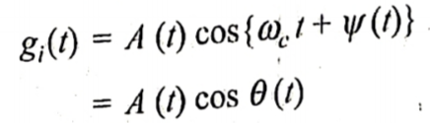
2. Noise Power
The input noise power is evaluated for baseband signal i.e. BW of message signal f(t) which is 2 . The input noise power is given by
The output noise power is computed assuming the message signal term f(t) to be zero. Therefore, the input to the detector will have carrier term plus noise term.
Substituting quadrature components of , we get
After trigonometric manipulations,

Slide 5
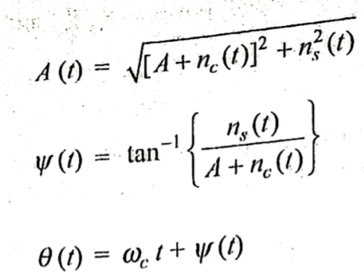





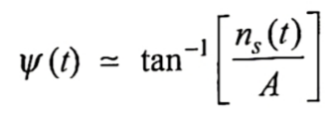



Where
Since the output of FM detector depends on the instantaneous frequency which is $\frac{d}{dt}$ , hence A(t) is not our interest.
Small noise case
In this case and and hence becomes
For small angle

Slide 6
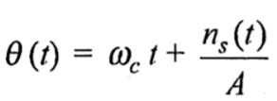

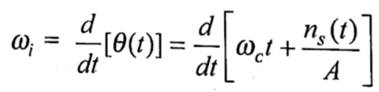
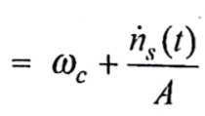
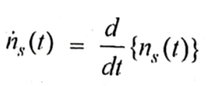


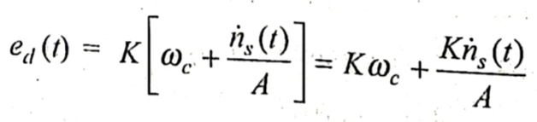

The corresponding value of is given by
The instantaneous frequency is given as
Where
The detected output is proportional to hence
The noise part of the detected output is given as

Slide 7

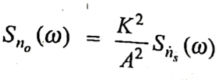


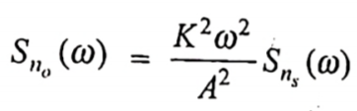



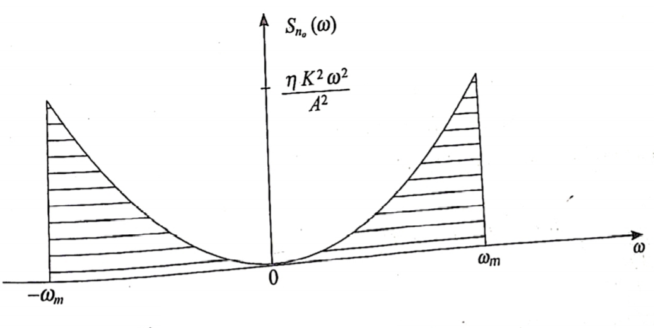
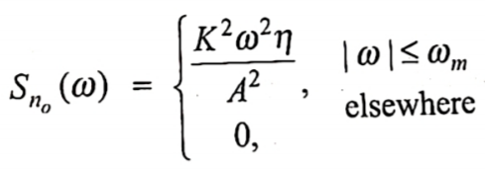
The power density spectrum of is given by
The power density spectrum of is related as
Substituting this in , we get
The detected output is bandlimited to . Therefore, . .
Thus, the output noise power spectrum density is given by:

Slide 8
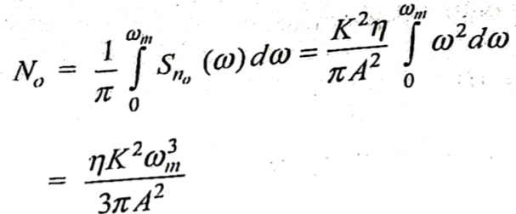


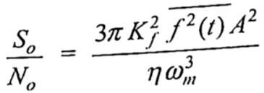

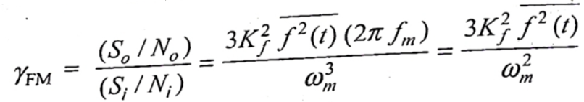
The output noise power is given by
The output noise power of FM detector varies inversely with carrier power . This is known as noise-quieting effect of carrier.
The output signal to noise ratio (So/No) is thus given by
3. Figure of Merit
The figure of merit of FM system is given by

Slide 9
Threshold effect in FM
When the carrier to noise ratio is slightly less than unity, the frequency of spike generation is small and each spike produces individual clicking sound in the receiver.
When CNR is further decreased so that the ratio is moderately less than unity, the spikes are generated rapidly and clicks merge into a sputtering sound – Threshold effect.
The minimum CNR for which FM noise improvement is not deteriorated significantly as compared to small noise case is defined as threshold.
If the CNR is less than the threshold value, the sputter effect causes distortion in the FM receiver and desired message signal cannot be resolved from noise.

Slide 10
Threshold improvement in FM
Threshold reduction or threshold improvement methods:
Pre-emphasis and De-emphasis
Frequency modulation with feedback (FMFB)
Pre-emphasis and De-emphasis
Simple RC networks are used to improve the threshold.
Noise power spectrum density increases as a parabolic function with frequency.
Message signal has a decaying Fourier spectrum with frequency. Hence So/No at the output of detector become very low towards the higher end of message band and may cause threshold effect.
To avoid this, So/No at higher edge of message band need to be improved. This is done using Pre-emphasis circuit.

Slide 11
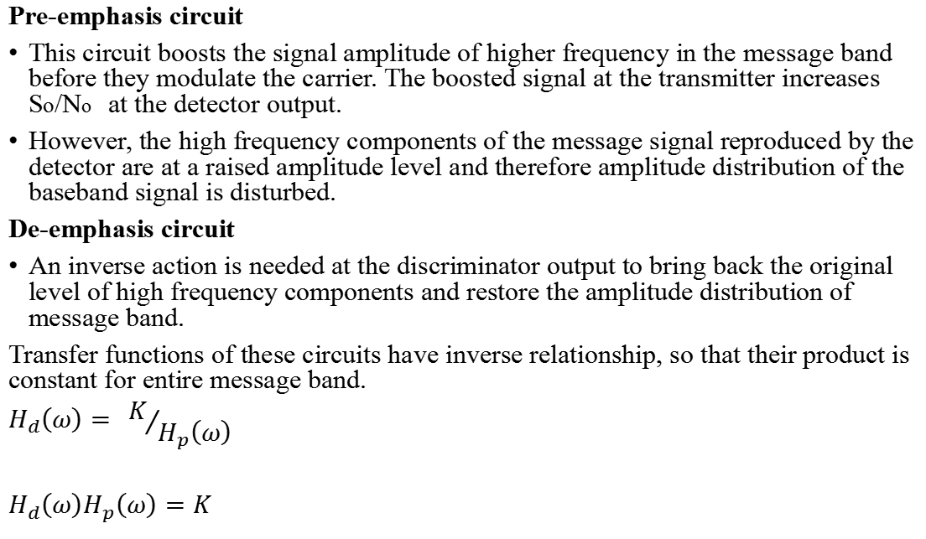
Pre-emphasis circuit
This circuit boosts the signal amplitude of higher frequency in the message band before they modulate the carrier. The boosted signal at the transmitter increases So/No at the detector output.
However, the high frequency components of the message signal reproduced by the detector are at a raised amplitude level and therefore amplitude distribution of the baseband signal is disturbed.
De-emphasis circuit
An inverse action is needed at the discriminator output to bring back the original level of high frequency components and restore the amplitude distribution of message band.
Transfer functions of these circuits have inverse relationship, so that their product is constant for entire message band.
$$H_{d}\left(ω\right)= K/{H_{p}\left(ω\right)}$$
$$H_{d}\left(ω\right)H_{p}\left(ω\right)=K$$

Slide 12
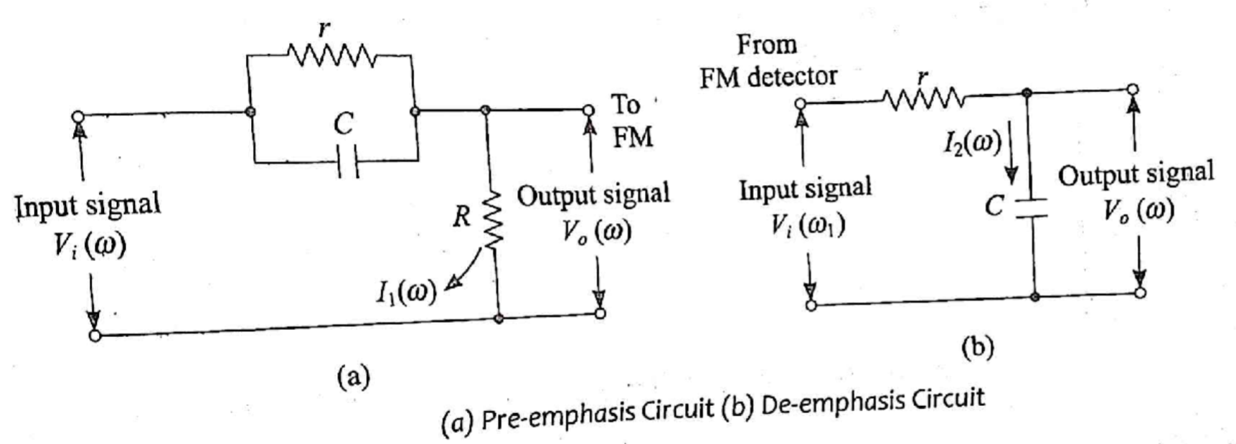
The pre-emphasis circuit at the transmitter is a high pass network which behaves like a differentiator.
De-emphasis is a low pass circuit behaving like an integrator.

Slide 13
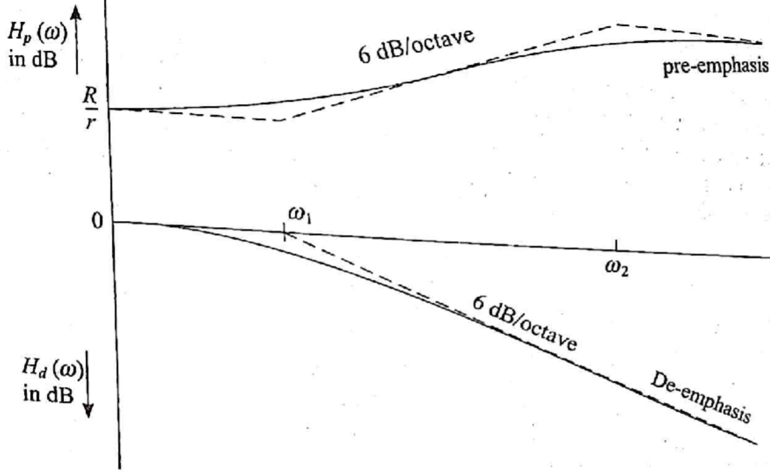
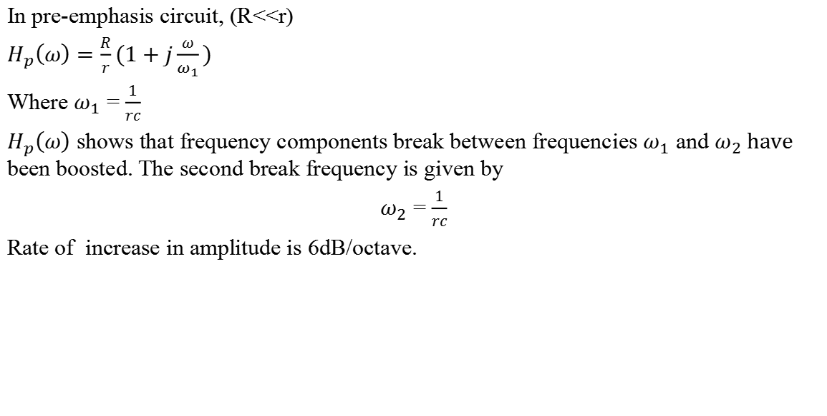
In pre-emphasis circuit, (R<<r)
$$H_{p}\left(ω\right)=\frac{R}{r}(1+j\frac{ω}{ω_{1}})$$
Where $ω_{1}$ = $\frac{1}{rc}$
$H_{p}\left(ω\right)$ shows that frequency components break between frequencies $ω_{1}$ and $ω_{2} have$ been boosted. The second break frequency is given by
$ω_{2}$ = $\frac{1}{rc}$
Rate of increase in amplitude is 6dB/octave.

Slide 14

For FM broadcast purpose, the lower frequency f1 is about 2.1KHz and the higher break frequency f2 is chosen to be much higher than the highest frequency term in the message band
The transfer function of De-emphasis is given by
$$H_{d}\left(ω\right)=\frac{1}{1+j\frac{ω}{ω_{1}}}$$

Slide 15
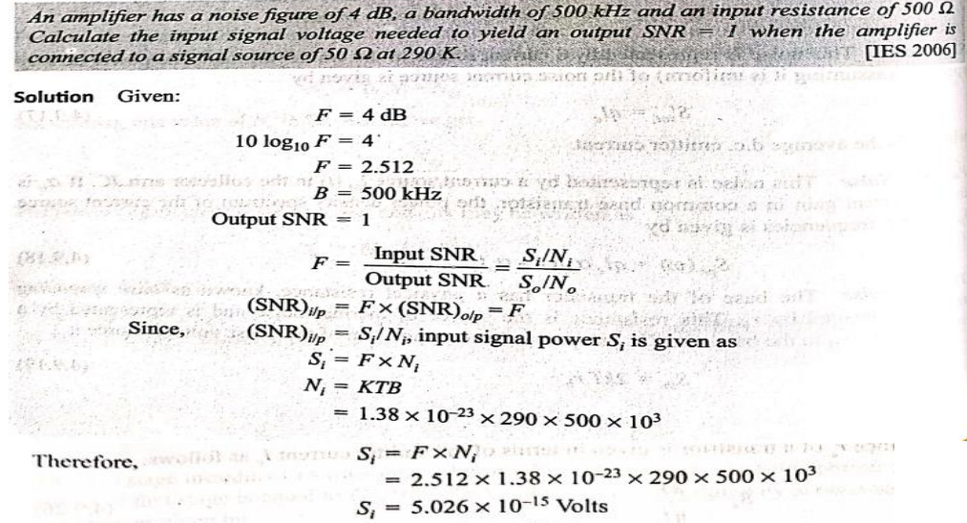
Problems

Slide 16
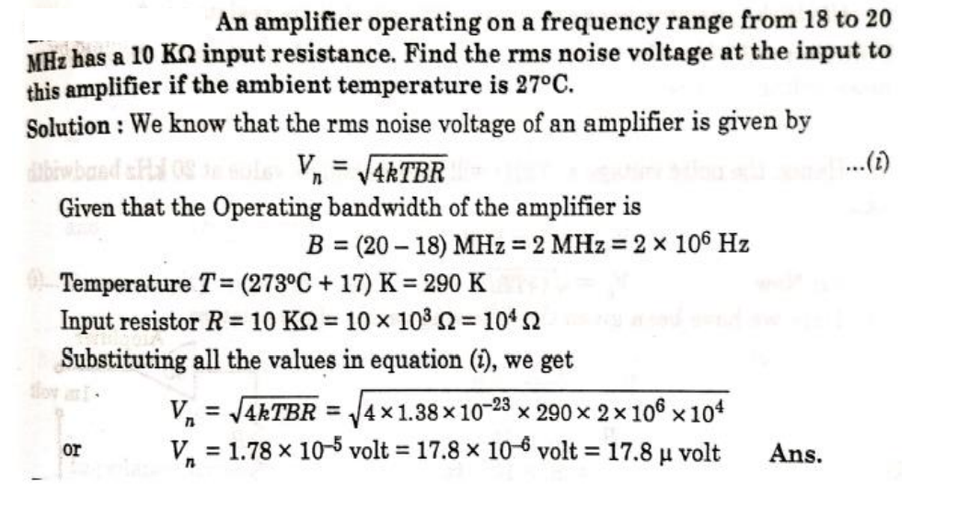
Problems:

Slide 17
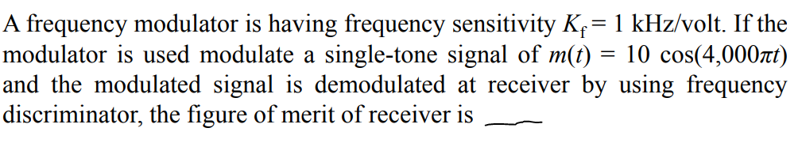
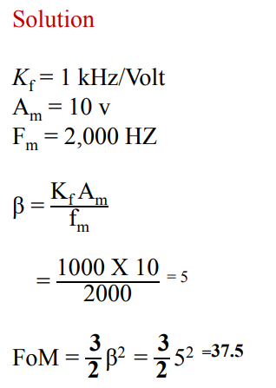
Problems:

